Slide 1


RELATIONAL DATABASE
Introduction to Databases
https://evermight.com

Slide 2


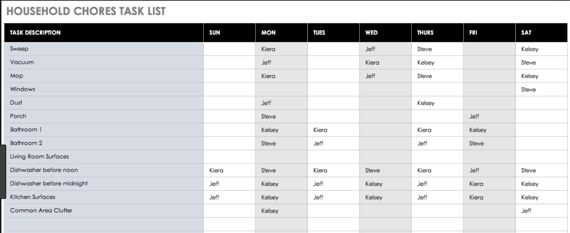
WHAT IS A DATABASE?

Slide 3
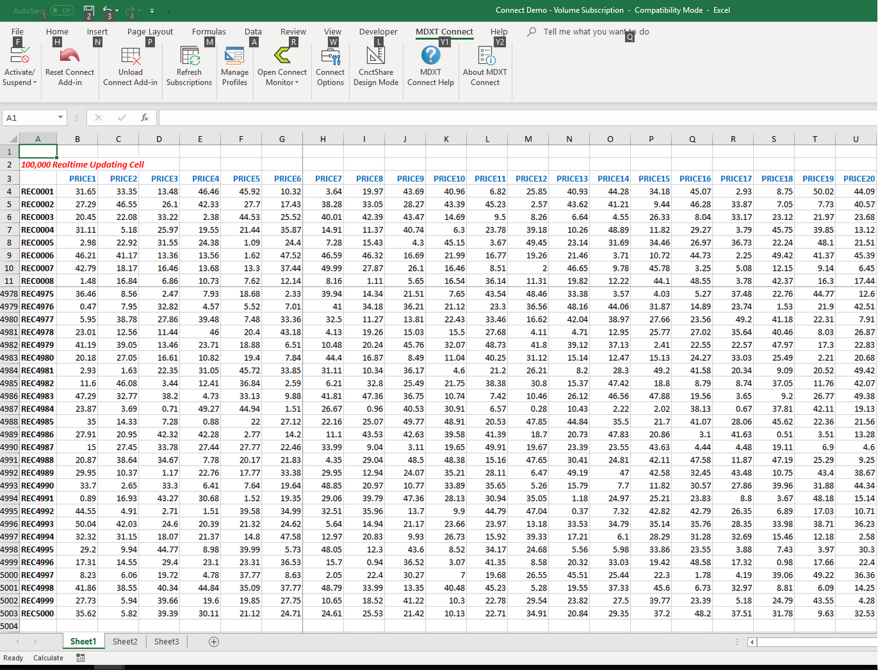

EXCEL AS DATABASE?

Slide 4
LIMITATIONS OF EXCEL
Remote Access – Can 1000 people edit at the same time?
Performance – Can your computer open a 2 TB Excel File?
Data Integrity – Can your Excel enforce rules for data completeness and correctness?
Standardization – Is everyone following the same conventions?

Slide 5
RELATIONAL VS. NON-RELATIONAL
Relational database – modelled after relational algebra. But commonly (and over-simplistically) explained as a way to describe relationships between different data types. Use Excel to demonstrate relational DB concepts. See education.xlsx
Non-relational database – anything that is not relational database. However, people now think of it as NoSQL databases

Slide 6
MANY RELATIONAL DB TECH
Company | RDB Software | E.g. SQL Statement – Add 5 days to create_date
Oracle | MySQL | SELECT DATE_ADD(create_date,INTERVAL 5 DAY) FROM t_vehicle
Oracle | Oracle RDBMS | SELECT DATE_ADD(create_date,INTERVAL 5 DAY) FROM t_vehicle
MariaDB Corp. | MariaDB | SELECT DATE_ADD(create_date,INTERVAL 5 DAY) FROM t_vehicle
PostgreSQL | PostgreSQL | SELECT create_date + INTERVAL ‘5 day’ FROM t_vehicle
Microsoft | SQL Server | SELECT DATEADD(DAY,5,create_date) FROM t_vehicle
IBM | DB2 | SELECT create_date + 15 DAYS FROM t_vehicle
The table above lists some companies (among many) that provide relational database software. For each relational database (RDB) software, you see an example Structured Query Language (SQL) statement that will select a date that is 5 days after a vehicle was inserted into the t_vehicle table. Notice that the SQL between different RDB software are very similar. The difference between the SQL in one RDB software to another is analogous to the differences in regional dialects of a human language.

Slide 7




GUI TO MANAGE DB

Slide 8
Technical Layers of a Cloud Software (Simplified)
Frontend
Other Android App / iOS App etc…
Web Browser HTML / CSS / JavaScript
Frontend layers reside completely on a user’s device
Backend layers reside completely on a remote server.
Frontend developers work on front end. Backend developers work on backend. Full stack developers work on both frontend and backend.
Although developers do their best to insulate one layer from the other, but generally speaking, the further down the technical stack you are, the more rigid the architecture will be. E.g. Changing a button in a web page on the front end may not affect your database structure. But changing your database structure will likely affect your middleware code and your web browser code.
Backend
Web Server Apache / Nginx / IIS / TomCat / HTTP Client etc…
Middleware PHP / C# / C++ / Java / Ruby / Python etc…
Database MySQL / SQL Server / DB2 / PostgreSQL etc…
Operating System Linux / Windows / Mac

Slide 9
FORMAL TERMINOLOGY
Entity – a table that reflects a real world business object. The object can be a concrete item such as an automobile or an abstract notion such as a financial transaction
Parent Entity – an entity which at least one other entity depends on Child Entity – an entity that depends on the existence of another entity Junction Table – a child entity that primarily stores Foreign Keys
Primary Key – a column or set of columns that uniquely defines the row in a table
Foreign Key – a column or set of columns that uniquely identifies a row in a parent entity

Slide 10
WHAT IS CRUD?
CREATE – INSERT INTO table (col1,col2…) VALUES (val1,val2…)
READ – SELECT * FROM table WHERE …
UPDATE – UPDATE table SET col1=val1, col2=val2 etc… WHERE …
DELETE – DELETE FROM table WHERE …

Slide 11
EXPORT / IMPORT
You can export a database as a *.sql file. You can simply import the *.sql file into a database to re-create all the tables and data. The *.sql file has all the necessary SQL statements to reproduce the database.
CSV Imports – you have to be very careful. Typical problems include character encoding and data quality/integrity.

Slide 12
WHAT ARE JOINS?
You can use INNER JOIN to connect tables together in a query.
E.g.
SELECT * FROM student INNER JOIN school ON school.school_id = student.student_id WHERE …
You can also use LEFT JOIN and RIGHT JOIN (to be explained in later workshops)

